Slide 1
S1 Stay with me
Group Performance

Slide 2
Today we will continue learning our ukulele chords as part of Sam Smith’s Stay with me. We will also learn the notation and rhythm for keyboard and glockenspiel.
Learning Intention

Slide 3
I can confidently play Am, F and C chords on the ukulele. I can perform as part of a group.
Success Criteria

Slide 4
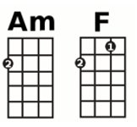
FRETS
STRINGS
4 3 2 1
Ukulele chords
Ceiling
4 3 2 1
4
3
2
1
4 3 2 1
Floor

Slide 5
Ukulele strumming pattern
Strumming pattern 1 – Minim beats
Strumming pattern 2 – Crotchet beats

Slide 6
Keyboard
Am
F
C

Slide 7
Glockenspiel
This part involves playing two notes at the same time.
Notice that a middle C is played with every note – use the left hand beater to play this.
*This is an example of a pedal note*

Slide 8
I can confidently play Am, F and C chords on the ukulele. I can perform as part of a group.
Success Criteria

Slide 9
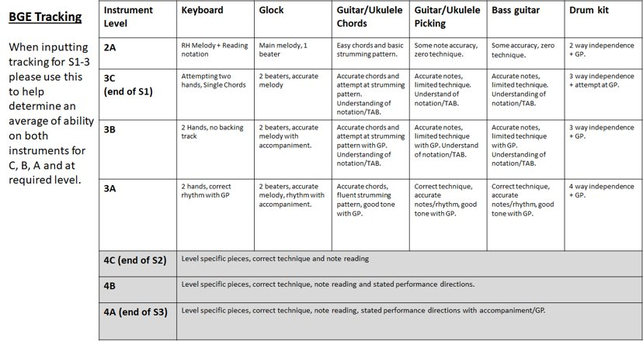
Evaluation

