Slide 1
S1 Stay with me
Strumming pattern 2 – Crotchet beats
Group Performance

Slide 2
Learning Intentions
Today we will be learning about the ukulele and how to perform specific chords on that instrument.
We will then use these skills to perform the chord structure from Sam Smith’s song Stay with me.

Slide 3
Success Criteria
I can confidently describe the parts of the ukulele.
I can perform specific chords on the ukulele and perform as part of a group.
I can evaluate my own and others performances providing next steps and targets.

Slide 5
Strumming position on ukulele
You should use your index finger nail to strum the strings.
Once you are confident with the chords we will introduce a strumming pattern.

Slide 6
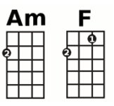
Ukulele chords
4 3 2 1
Ceiling
4
3
2
1
Floor

Slide 7
Ukulele chords
FRETS
STRINGS
4 3 2 1
Ceiling
4 3 2 1
4
3
2
1
4 3 2 1
Floor

Slide 8
Ukulele A minor (Am) chord
4 3 2 1

Slide 9
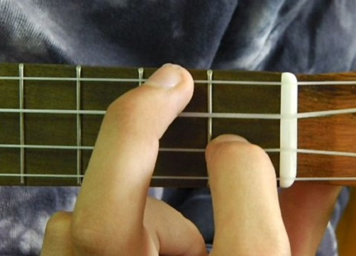
Ukulele F chord
4 3 2 1

Slide 10
Ukulele A minor (Am) chord
4 3 2 1

Slide 11
Ukulele strumming pattern
Strumming pattern 1 – Minim beats
Strumming pattern 2 – Crotchet beats

Slide 12
Ukulele strumming pattern
Strumming pattern 1 – Minim beats
Strumming pattern 2 – Crotchet beats

Slide 13
Success Criteria
I can confidently describe the parts of the ukulele.
I can perform specific chords on the ukulele and perform as part of a group.
I can evaluate my own and others performances providing next steps and targets.

